Slide 1
Do Not Blame Users for Misconfigurations
Tianyin Xu, Jiaqi Zhang, Ryan Huang Jing Zheng, Tianwei Sheng, Ding Yuan, Yuanyuan Zhou, Shankar Pasupathy*
UC San Diego *NetApp
Presenter: 黄汇
Notes:
SOSP 2013

Slide 2

How many of you have
made mistakes when configuring systems?

Slide 3
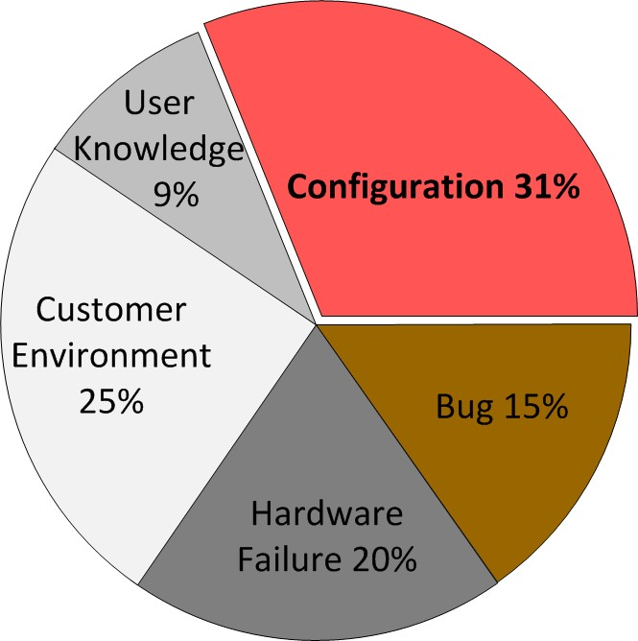
You Are Not Alone!
Root causes of “high-severity” customer issues
in a major storage company [Yin et al, SOSP’11]

Slide 4
Unfortunately, many developers
think they are users’ faults!
“It is not a bug, but an invalid setting.”
Developers of a mature open-source server app.

Slide 5
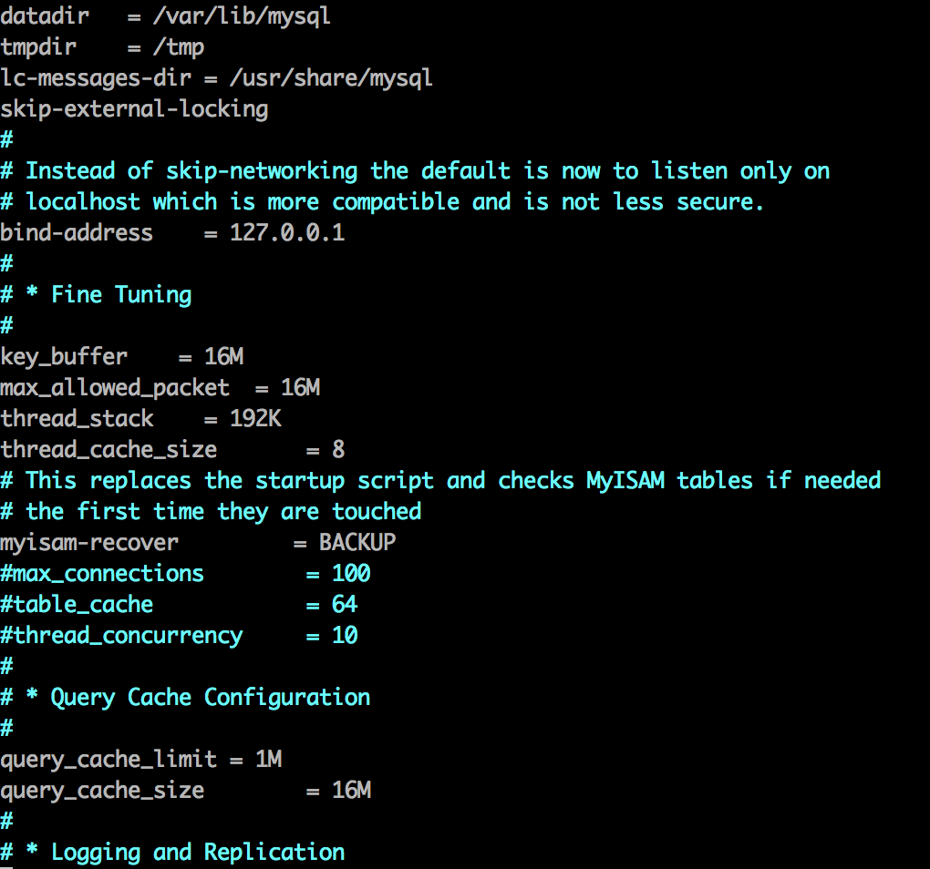

Configuration Is a User Interface!

Slide 6
Goal #1: React Gracefully to Misconfig.
Today’s systems are vulnerable to misconfig.
Software Systems | Crashes & Hangs w/o Message
Storage-A | 8.4%
CentOS | 6.7%
MySQL | 16.4%
Apache | 5.0%
OpenLDAP | 4.8%
The impact distribution of misconfigurations [Yin et al, SOSP’11]

Slide 7

Goal #2: Intuitive & Less Error-prone
/* A Commercial Storage System*/
InitiatorName = iqn_DEV_domain
Error!
Lower-case only
Error-prone constraint
Several customers made the same mistakes.

Slide 8
Our Contributions
Spex: automatically infer config. constraints
by statically analyzing source code (for developers)
Use cases
Expose misconfig. vulnerabilities
Detect error-prone config. design & handling
Improve config. design of real-world systems
1 commercial and 6 open-source systems
Expose 743 vulnerabilities (364 confirmed/fixed)
Detect 112 error-prone constraints (80 fixed)
Experience in interacting with developers
Improve Squid’s config. lib (benefit 150+ parameters)

Slide 9
Our Contributions
Spex: automatically infer config. constraints
by statically analyzing source code (for developers)
Use cases
Expose misconfig. vulnerabilities
Detect error-prone config. design & handling
Improve config. design of real-world systems
1 commercial and 6 open-source systems
Expose 743 vulnerabilities (364 confirmed/fixed)
Detect 112 error-prone constraints (80 fixed)
Experience in interacting with developers
Improve Squid’s config. lib (benefit 150+ parameters)

Slide 10

Spex Overview
Source Code
# Config file
Max_threads=50
Mapping
…=…
…=…
Mapping
Spex
Inference
# Source code
if (ThreadNum<100) {
Config
Constraints
…
}

Slide 11

Spex Overview
Source Code
Mapping
var x var y
Spex
Inference
Config
Constraints
Notes:
Dataflow path

Slide 12
Mapping Is Non-trivial
Cannot ask developers to annotate every parameter
Investigated 18 software projects, all but one use one of the following mapping conventions.
 | Mapping convention | What need to be annotated? | # Software projects
 | Structure-based | Data structure(s) | 9
 | Comparison-based | Parsing function | 4
 | Container-based | Getter functions | 4

Slide 13


Structure-based Mapping
PostgreSQL-9.2.1
deadlock_timeout
= 10
struct config_int
ConfigureNamesInt[] =
{
{“deadlock_timeout”,
…,
&DeadlockTimeout, …, },
…
{“max_connections”,
…,
&MaxConnections, …, },
…
Annotation
@STRUCT = ConfigureNamesInt
@PAR = [config_int, 1]
@VAR = [config_int, 3]
}
80 more mappings

Slide 14
Comparison-based mapping
void loadServerConfig(...) { ...
if (!strcasecmp(argv[0],"timeout")) {
server.maxidletime = atoi(argv[1]);
...
} else if(...)
...
}
/* Redis-2.4.17 */
timeout
= 10
Annotation
@PARSER = loadServerConfig
@PAR = $argv[0]
@VAR = $argv[1]

Slide 15
What Constraints Can Be Inferred?
Data type
Basic type: integer, float, string, boolean
Semantic type: file path, IP address, port
Data range
- e.g., [10, 100], {‘yes’, ‘no’}
Control dependency
e.g., X dominates Y’s executions
Value relationship
e.g., X < Y
First Pass
Second Pass
Notes:
SPEX scans the source code twice.
Basic type: record the type after the first casting
Semantic type: 1. infer from system/library call 2. compare/assign with known function call

Slide 16

Data Type Inference
Methodology
– Check the variable’s data type and how the variable is used in syscall/libcall
# Config parameter
“ft_stopword_file”
int ft_init_stopwords(…) {
fd = my_open(ft_stopword_file, …);
…
}
File my_open(const char * FileName, …) {
…
fd = open((char*) FileName, Flags);
ft_stopword_file
FileName
FileName
}
A file path
/* MySQL-5.5.29 */

Slide 17

Data Range Inference
Methodology
– If the variable is compared with a constant value, inspect the branch block to decide the range.
# Config parameter
“index_intlen”
static int config_generic (…)
{
…
if(c->value_int
< 4)
c->value_int
c->value_int = 4;
Data range: [4, 255]
else if(c->value_int
> 255)
c->value_int
c->value_int = 255;
…
}
/* OpenLDAP-2.4.33 */
Notes:
such information is used to guide misconﬁguration injection, some false positives are not a major concern.

Slide 18


Control Dependency Inference
Methodology
– Check if the config variable’s usage is controlled by
another config variable
# Config parameter:
“fsync”
“commit_siblings”
static TransactionId
RecordTransactionCommit() {
…
if(enableFsync &&
MinimumActiveBackends(CommitSiblings)){
…
enableFsync
CommitSiblings
}
“commit_siblings” takes
}
/* PostgreSQL-9.2.1 */
effect iff “fsync” is enabled
*All commit_siblings’s use sites are inside the func call.
Notes:
SPEX aggregates all the inferred control dependencies for each parameter from all control-ﬂow paths, and calculates the MAYbelief conﬁdence of each dependency

Slide 19
Our Contributions
1. Spex: automatically infer config. constraints
by statically analyzing source code (for developers)
Use cases
Expose misconfig. vulnerabilities
Detect error-prone config. design & handling
Improve config. design of real-world systems
1 commercial and 6 open-source systems
Expose 743 vulnerabilities (364 confirmed/fixed)
Detect 112 error-prone constraints (80 fixed)
Experience in interacting with developers
Improve Squid’s config. lib (benefit 150+ parameters)

Slide 20
Use Case of Constraints #1
Expose misconfig. vulnerabilities
- Misconfig. injection testing
Type | Constraint | Config. Error
Basic type | A is an integer | A := 2XX
Semantic type | B is a file path | B := invalid path
Data range | C ∈ [10, 100] | C := 1000
Ctrl dep. | D depends on E | D := yes, E := no
Value rel. | F > H | F < H

Slide 21

Expose Vulnerability
MySQL-5.5.29
ft_stopword_file dir_path
file_path
Program received signal SIGSEGV, Segmentation fault. my_mb_ctype_8bit (cs=0x1226760,
ctype=0x7fffffffde00, s=0x1ad5000 <Address
0x1ad5000 out of bounds>, e=0x10185a67f
<Address 0x10185a67f out of bounds>) at
./strings/ctype-simple.c:1299 1299 *ctype=
cs->ctype[*s + 1];
……

Slide 22
The category of bad system reactions
Reaction | Description
Crash/Hang | The system crashes or hangs.
Early termination | The system exits without pinpointing the injected conﬁguration error.
Functional failure | The system fails functional testing without pinpointing the injected error.
Silent violation | The system changes input conﬁgurations to different values without notifying users.
Silent ignorance | The system ignores input conﬁgurations (mainly for control-dependency violation).

Slide 23
Use Case of Constraints #2
Detect error-prone config. design & handling
Design inconsistency (case sensitivity, unit)
Silent overruling
Unsafe APIs
Undocumented constraints
Notes:
Unsafe APIs: atoi, sscanf and sprintf are vulnerable to erroneous user inputs. (use strtol instead)

Slide 24
Silent Overruling
if(!strcasecmp(token, "on")) {
*var = 1;
} else {
*var = 0;
}
/* src/cache_cf.cc */
Input from user
"yes" and "enable" are treated as "off" silently

Slide 25
Our Contributions
1. Spex: automatically infer config. constraints
by statically analyzing source code (for developers)
Use cases
Expose misconfig. vulnerabilities
Detect error-prone config. design & handling
Improve config. design of real-world systems
1 commercial and 6 open-source systems
Expose 743 vulnerabilities (364 confirmed/fixed)
Detect 112 error-prone constraints (80 fixed)
Experience in interacting with developers
Improve Squid’s config. lib (benefit 150+ parameters)

Slide 26
Software Evaluated
Software | Proprietary | LOC | # Parameters | LOA*
Storage-A | Commercial | -- | > 1000 | 5
Apache | Open source | 148K | 103 | 4
MySQL | Open source | 1.2M | 272 | 29
PostgreSQL | Open source | 757K | 231 | 7
OpenLDAP | Open source | 292K | 86 | 4
VSFTP | Open source | 16K | 124 | 5
Squid | Open source | 180K | 335 | 2
*LOA: lines of annotation
Notes:
Mapping parameters

Slide 27
Exposed Misconfig. Vulnerabilities
Software | Crash/ Hang | Early Termina. | Function Failure | Silent Violation | Silent Ignor. | Total
Storage-A | 0 | 0 | 7 | 74 | 83 | 164
Apache | 5 | 4 | 9 | 29 | 5 | 52
MySQL | 5 | 10 | 12 | 71 | 16 | 114
PostgreSQL | 1 | 10 | 2 | 1 | 35 | 49
OpenLDAP | 1 | 3 | 6 | 7 | 0 | 17
VSFTPD | 12 | 5 | 18 | 23 | 68 | 126
Squid | 2 | 3 | 29 | 173 | 14 | 221
Total | 26 | 35 | 83 | 378 | 221 | 743

Slide 28
Detected Inconsistency
Software | Case Sensitivity |  | Fixed parameters
 | Sensitive | Insensitive
Storage-A | 32 (7.1%) | 453 (92.3%) | 0
Apache | 3 (11.5%) | 26 (88.5%) | 3
MySQL | 1 (1.7%) | 58 (98.3%) | 1
PostgreSQL | 0 (0%) | 92 (100%) | N/A
OpenLADP | 0 (0%) | 9 (100%) | N/A
VSFTP | 0 (0%) | 73 (100%) | N/A
Squid | 85 (52.8%) | 76 (47.2%) | 76
Total |  |  | 80
Notes:
Design inconsistency, silent overruling

Slide 29
Can We Help Real-world Misconfig.?
Software | Real-world misconfig. | Bad reactions that can be potentially avoided
Storage-A | 246 | 68 (27.6%)
Apache | 50 | 19 (38.0%)
MySQL | 47 | 14 (29.8%)
OpenLDAP | 49 | 12 (24.5%)

Slide 30
Inference Accuracy
Software | Basic Type | Semantic Type | Data Range | Control Dep. | Value Dep.
Storage-A | 97.0% | 95.7% | 87.1% | 84.1% | 94.7%
Apache | 96.1% | 91.7% | 94.6% | 100.0% | 81.8%
MySQL | 100.0% | 98.7% | 99.1% | 94.7% | 71.4%
PostgreSQL | 100.0% | 96.3% | 97.3% | 91.7% | 85.7%
OpenLDAP | 88.2% | 93.7% | 73.1% | N/A | 50.0%
VSFTP | 100.0% | 100.0% | 100.0% | 63.9% | 100.0%
Squid | 77.0% | 100.0% | 100.0% | 77.8% | 100.0%
Notes:
the inaccuracy is mainly caused by pointer aliasing.

Slide 31
Our Contributions
1. Spex: automatically infer config. constraints
by statically analyzing source code (for developers)
Use cases
Expose misconfig. vulnerabilities
Detect error-prone config. design & handling
Improve config. design of real-world systems
1 commercial and 6 open-source systems
Expose 743 vulnerabilities (364 confirmed/fixed)
Detect 112 error-prone constraints (80 fixed)
Experience in interacting with developers
Improve Squid’s config. lib (benefit 150+ parameters)

Slide 32
Experience (Positive ☺)
Storage-A:
Slides sent to all the developers
Squid:
Improve the config. lib. (150 parameters benefit)
364 detected misconfig. vulnerabilities have been
confirmed or fixed by developers.
80 detected error-prone constraints have been fixed by developers.
Notes:
Squid: Web cache proxy

Slide 33
Experience (Negative ☹)
“It is not a bug, but an invalid setting.”
“Those who do (configuration) typically read the code.”
“If you work exactly and carefully it does not matter; if not, you should not maintain a server at all.”
Notes:
Most users never adjust these values. Those who do, read the code.

Slide 34
Limitations
We cannot infer all the constraints, e.g., domain-specific, cross-software
The inference is not 100% accurate
More fundamental approach is to rethink and redesign of configuration

Slide 35
Conclusions
Take a more active role in handling misconfig.
- Configuration is a user interface!
Spex: a tool that automatically infers config. constraints from source code.
Exposed 741 vulnerabilities (364 confirmed/fixed)
Detected 112 error-prone constraints (80 fixed)

Slide 36

Thanks!

